Slide 1

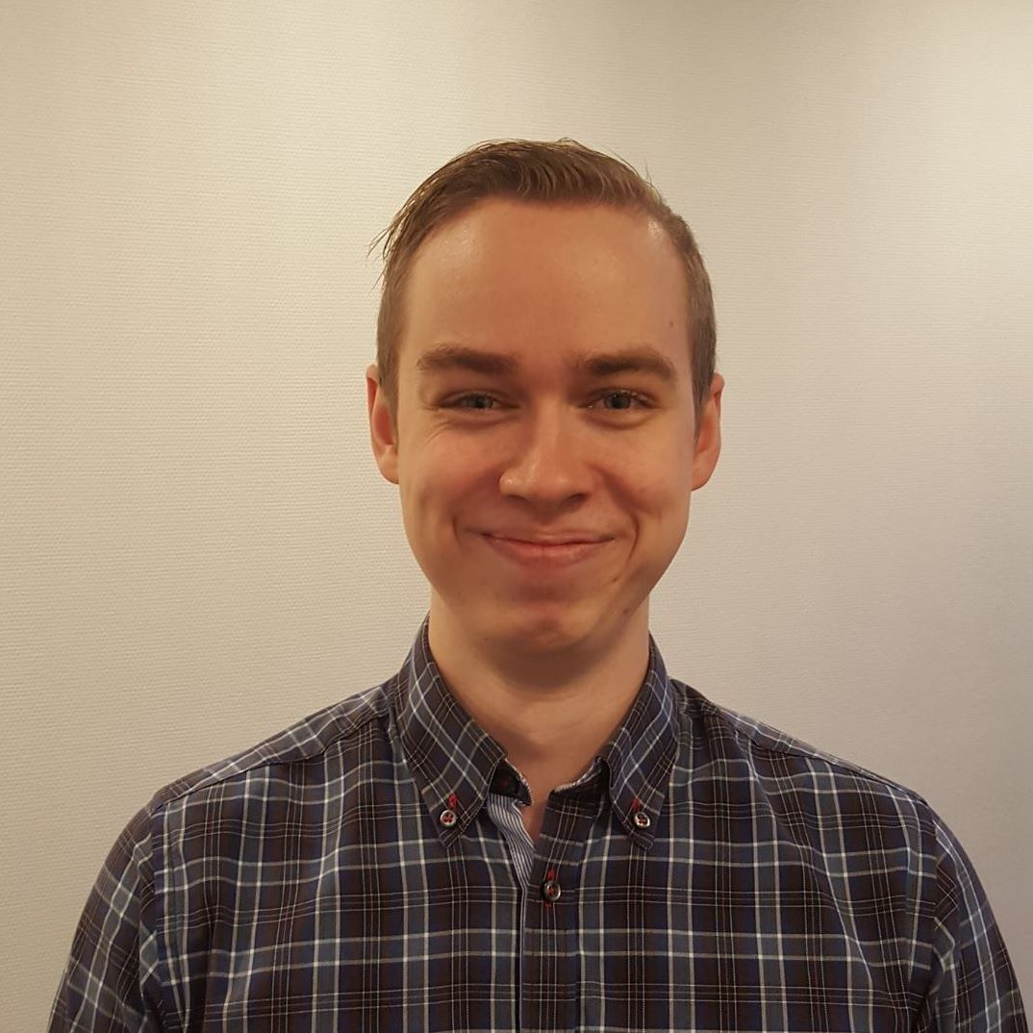


The
Archi
tects
Notes:
Ramuld

Slide 2

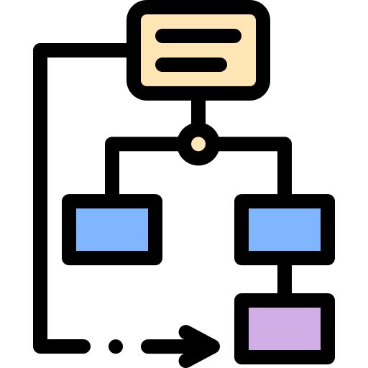


Agenda
A to Z Overview
In-depth with Bet placement
In-depth with aSQA
In-depth with 3+1
Notes:
JACOB

Slide 3

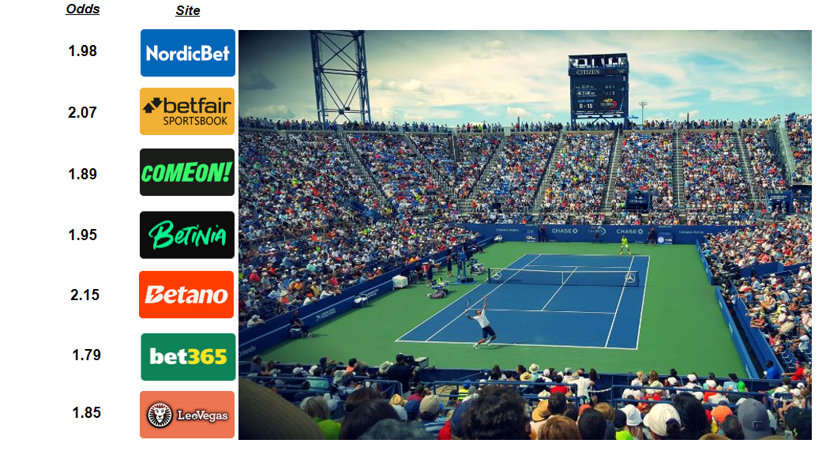
Notes:
JACOB

Slide 4

Analysis
ASR’s
Qualities
Performance
Modifiability
Safety
World cups
Many odds updated
Many logins
Many bets to forward
Bookmakers
Remove
Add
Changing API
Bets placement
Odds change before confirmation
Different thresholds
Scenarios:
Usability
Not prioritized:
Branding
Settings supporting favourite teams
Site preferring matches by favourite teams
Notes:
JACOB
Stakeholders such as major sports clubs, and their desire for branding was not prioritized

Slide 5

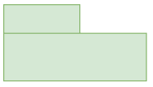
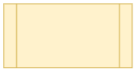
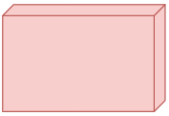
Synthesis
Module
C&C
Allocation
Notes:
THOR

Slide 6

Prototype
Early validation of applied patterns/tactics to gains attribute:
Experimental - Performance
Exploratory - Safety
Notes:
RAMULD

Slide 7
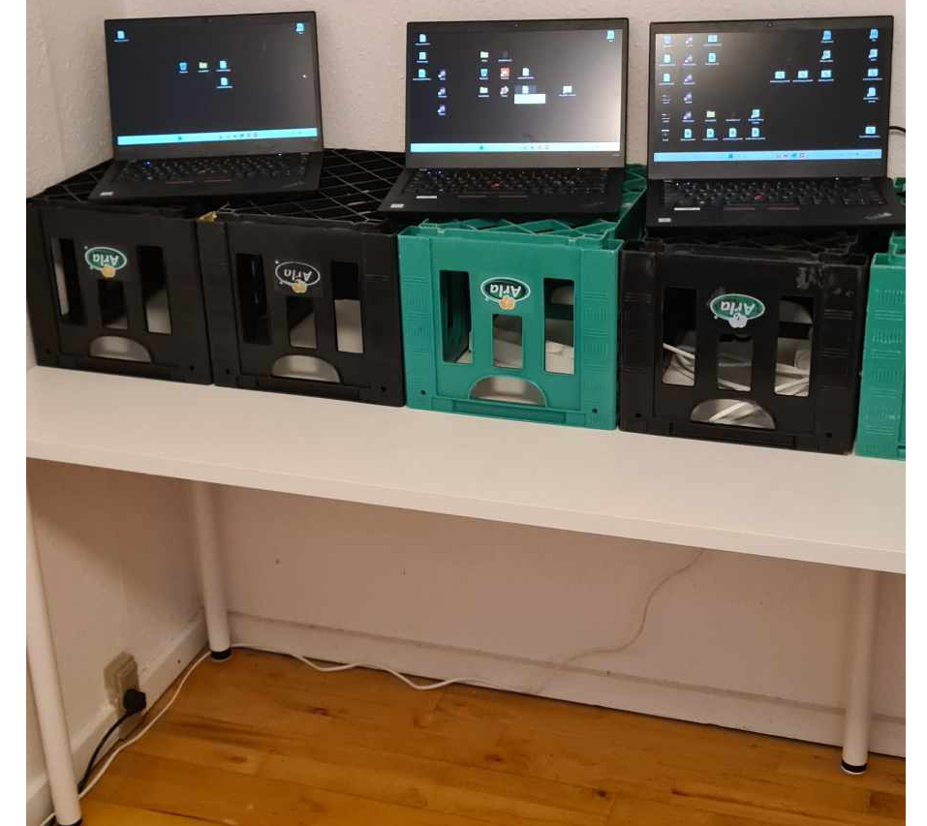
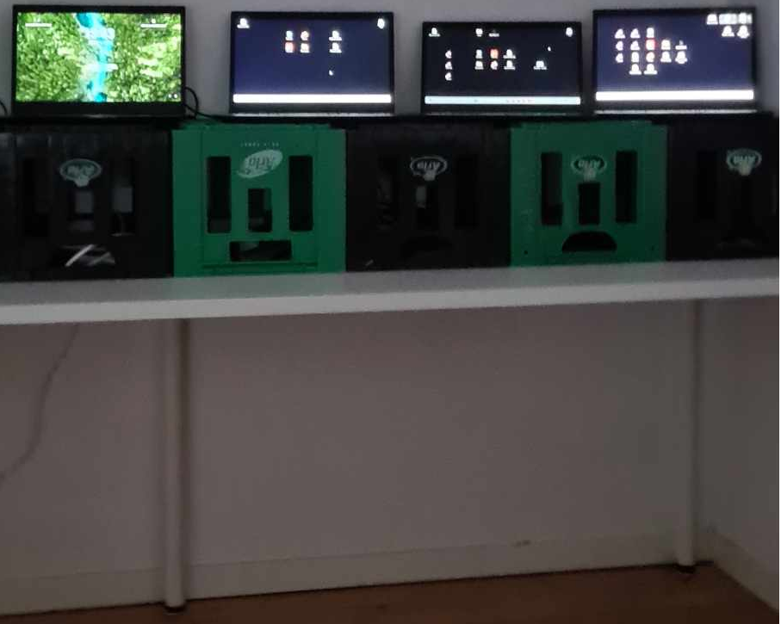
Test setup
* All are Lenovo Thinkpads T490 * All are on different networks Courtesy of Grumlebet
Microkernel Load balancer / Actor forwarder
Multiple clients
Multiple servers / actors
Notes:
Jacob

Slide 8



Evaluation
ATAM or aSQA
2
Iterations
Notes:
RAMULD
ATAM (Architecture Trade-off Analysis Method) is heavy. aSQA (arch. software quality assurance) has iterative focus.
With aSQA. Easier to directly compare different suggstions.
We had two iterations: before and after improvement.

Slide 9
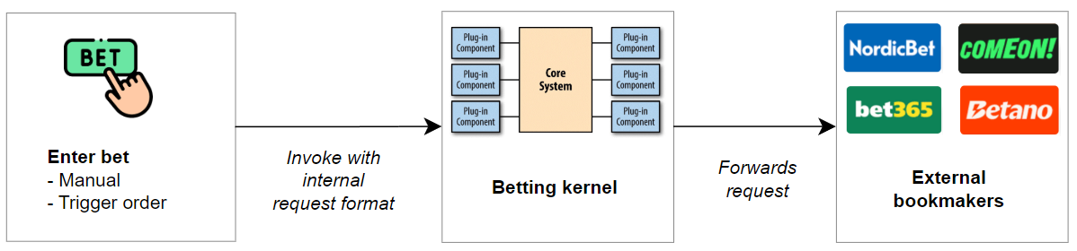
Zooming in on Bet placement
Notes:
Jacob

Slide 10
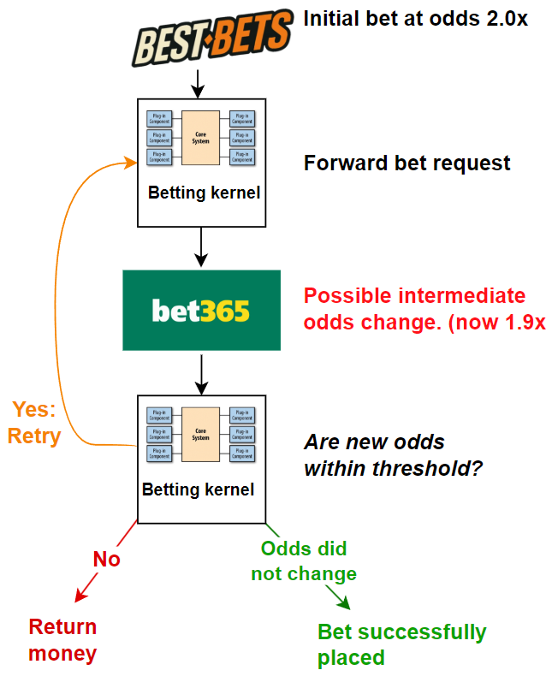
Transaction - Start of transaction: Initial bet placement
- End of transaction: Final confirmation/rejection
Tactic:
Notes:
Ramuld

Slide 11
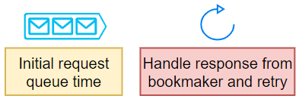
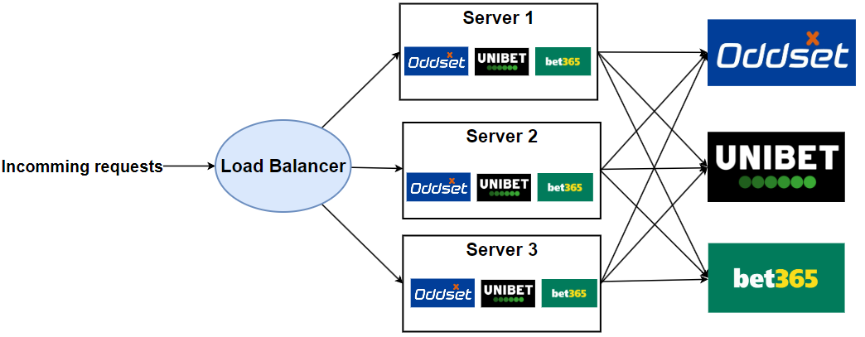
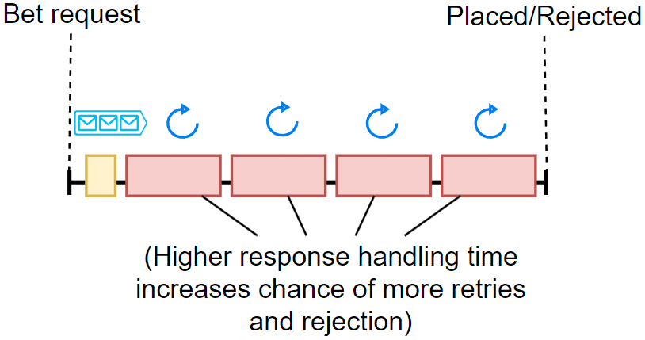
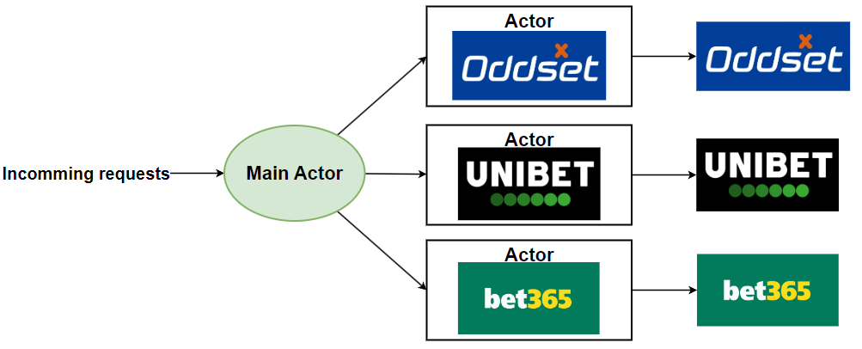
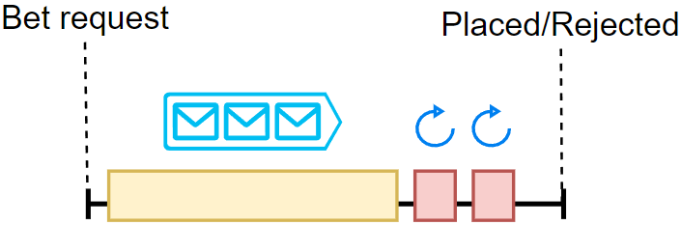
Patterns:
Load balancer for performance
Actor model for bet safety
Notes:
Jacob slides
Load balancer: Experimental
Actor: Exploratory
When main actor is ready for you, It will spin up a “personal actor” making the retries fast.
Load balancer:

Slide 12
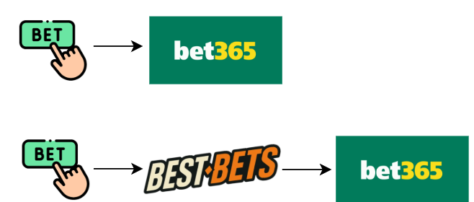
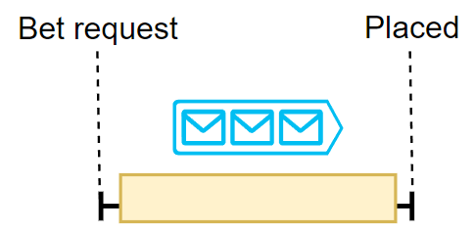
Pause for a second - Why is this important?
1. Retries often results in bet rejection
Extra risk of retrying
2. Our patterns solve two different real-world problems
90 % cases
10 % cases
Notes:
With only a load balancer it could potentially struggle with placing most bets.

Slide 13
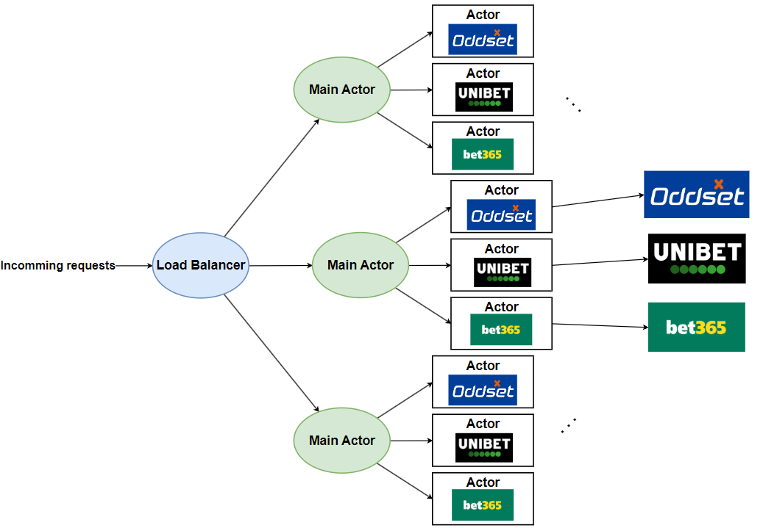
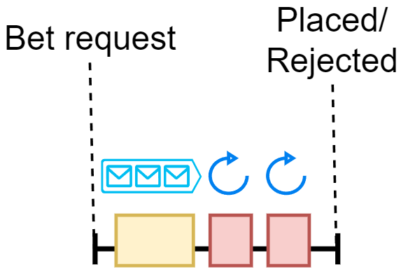
Load balanced Actor Model
Notes:
Jacob

Slide 14
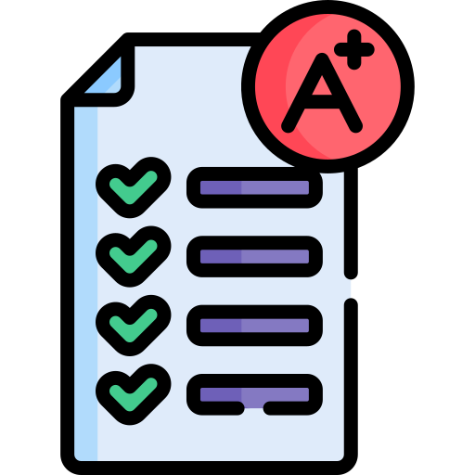
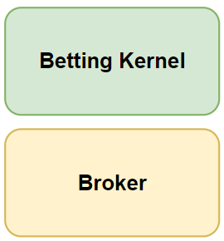
In-depth Evaluation with aSQA
Scores
2 Components
Notes:
Some scored based on prototype. Rest are guesstimates. 1-5 from the literature. Architectural vs implementation perspective
Metrics were hard to define for guesstimates.
Two main modules. 3 components in first iteration. 2 in second.

Slide 15

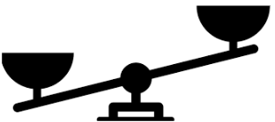
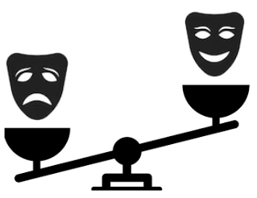
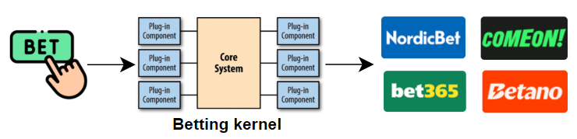
The Betting Kernel
Actor Model Load Balancer → Load Balanced Actor Model Target
Performance
Modifiability
Safety
2 5 5 5
5 4 3 4
4 1 4 4
Notes:
The initial tradeoff: Safety vs Performance.
The new trade-off. Performance and safety has higher importance. Lower modifiability
Higher importance than broker because this is where users place money

Slide 16
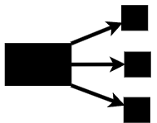
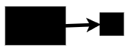
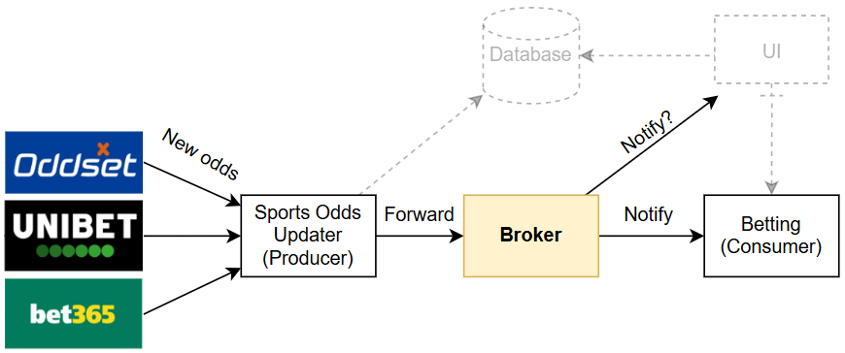
The broker
Global Odds Broker → Trigger Order Broker Target
Performance
Modifiability
2 3 4
2 4 3
Notes:
Global to trigger orders only.
The hidden trade-off. Now UI updates must be handled else-wise
Overall aSQA helped with small agile improvements.
It helped focus on individual parts of the system so we could make small improvements and not lock down big architectural decisions too early.

Slide 17
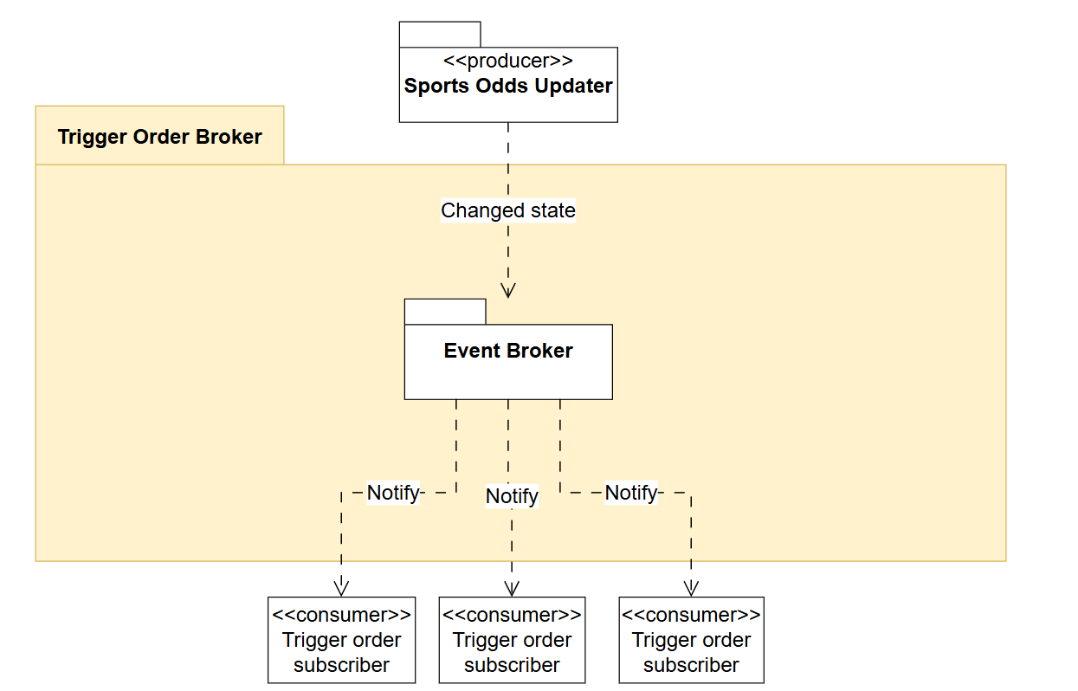
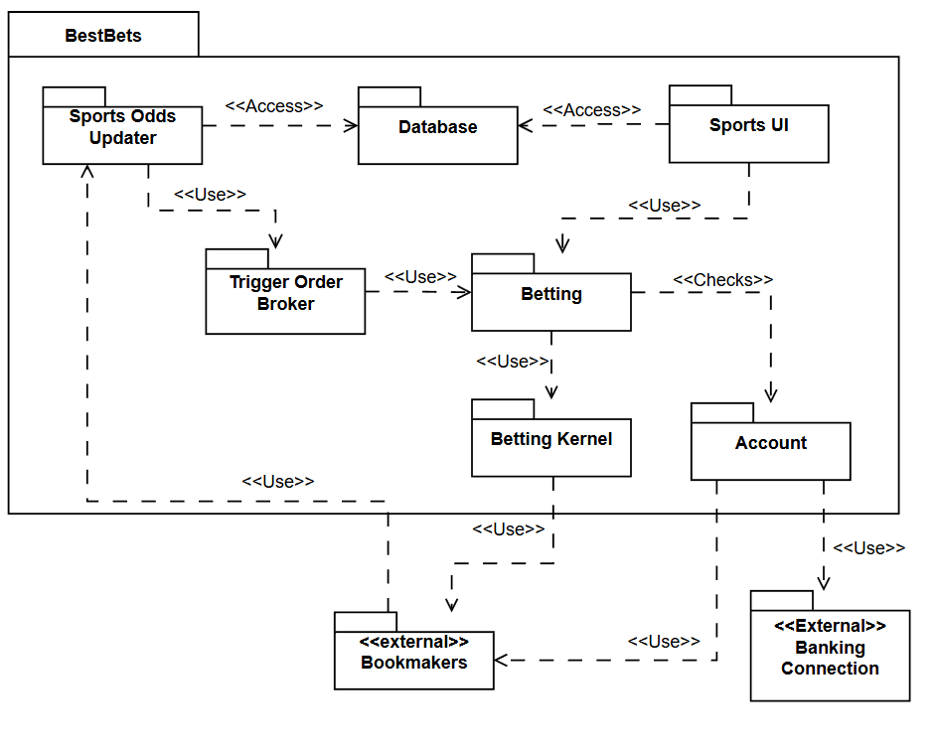
In-depth with 3+1
Notes:
Iterative process making views ->
Interesting to prototype Event Broker -> Is in backlog
Monolithic structure

Slide 18
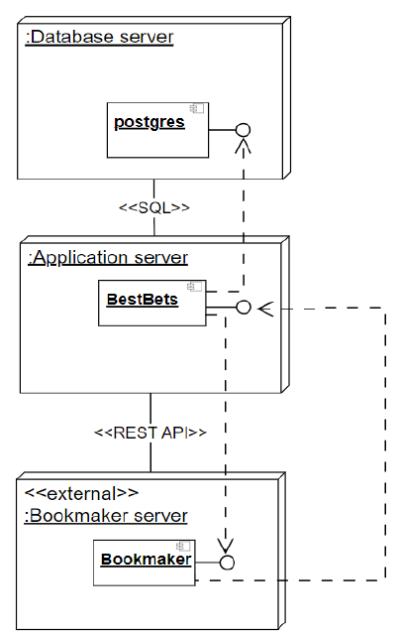

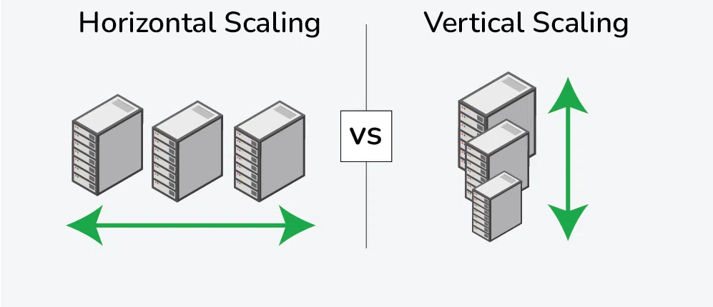
Scaling of system
Deployment view
Microservices?
Notes:
Focussed on performance and safety -> No horizontal scaling in deplyoment view
Microservice instead of monolithic structure (Good modifiability, could help solve database concerns)
- Could still be an area of interest in fututure
- Would have made more sense if Availability scores highest

Slide 19
Thank you

